Slide 1
Software Engineering
By: M.Aamir Saleem
Amir.saleem@gift.edu.pk

Slide 2
Software Testing
Software testing is a process, to evaluate the functionality of a software application with an intent to find whether the developed software met the specified requirements or not and to identify the defects to ensure that the product is defect free in order to produce the quality product.

Slide 3
Software Testing
Why testing needed?

Slide 4
Software Testing Overview
Software Verification
Adhering to the proper specifications and methodologies.
Are we building the product right?
Reviews, Inspections, Walk Throughs
Software Validation
Examining whether or not the software satisfies the user requirements.
Are we building the right product
Testing

Slide 5
Software Testing Overview
Testing Types
Manual Testing
Without taking help of automated testing tools
Time and resource consuming
Automated Testing
With the help of automated testing tools
Limitations with manual testing can be overcome

Slide 6
Software Testing Overview
Testing Methods
Static Testing
Dynamic Testing

Slide 7
Software Testing Overview
Testing Approaches
Black Box
White Box
Gray Box

Slide 8
Software Testing Overview
Testing Levels
Unit Testing
Integration Testing
System Testing
Functional Testing
Non-Functional Testing

Slide 9
Software Testing Overview
Testing Levels
Acceptance Testing
Alpha Testing
Beta Testing
Regression Testing

Slide 10
Software Testing Overview
Testing Doc
Before Testing
SRS
Test Policy
Test Strategy
Trackability Matrix

Slide 11
Software Testing Overview
Testing Doc
During Testing
Test Cases
Test Description
Test Report
Test Log

Slide 12
Software Testing Overview
Testing Doc
After Testing
Test Summary
Bug Report
Release Notes
User manual

Slide 13
What is Agile Testing?
Agile Testing involves all members
Testing is not a separate phase and is interwoven
Testing takes place simultaneously in SDLC
Testers participating in the entire Development Lifecycle
Agile Testing covers all the levels of testing and all types of testing

Slide 14
Agile Testing Vs. Waterfall Testing
Agile Testing | Waterfall Testing
Testing is not a separate phase | Testing is a separate phase
Testers and developers work together. | Testers work separately from developers.
Testers are involved in the requirements phase. | Testers may not be involved in the requirements phase.
Acceptance Testing is done after every iteration and customer feedback is sought | Acceptance Testing is done only at the end of the project.
Regression testing to be implemented every time new functions or logic are released. | Regression Testing can be implemented only after the completion of development.
No time delays between coding and testing. | Usual time delays between coding and testing
Continuous testing with overlapping test levels. | Testing is a timed activity and test levels cannot overlap.

Slide 15
Agile Testing Principles
Testing moves the project forward -Testing is not a phase
Everyone Test -Keep the Code Clean
Lightweight Documentation
One test artifact for manual and automated tests
“Done Done” not just done

Slide 16
Agile Testing Phases
Development: Majority of the testing occurs during the Construction phase. Under this phase, software testing is funneled down to the prioritized requisites.
Release: It is the process of deploying the system successfully into production. Training of end users, support people, and operational people fall under this stage.

Slide 17
Agile Testing Activities
Release Planning (Test Plan)
For every Iteration
Agile Testing Activities during an Iteration
Regression Testing
Release Activities (Test Related)

Slide 18
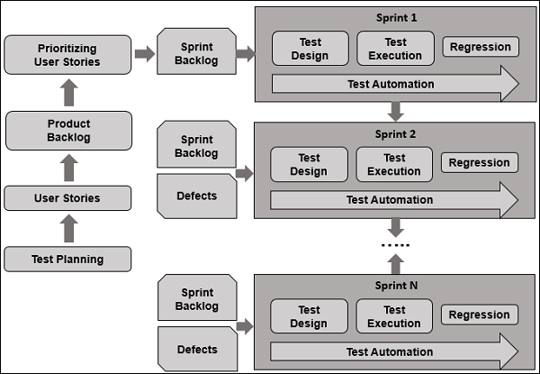
Agile Testing Lifecycle

Slide 19
Agile Testing During an Iteration
Participating in iteration planning - Estimating tasks from the view of testing
Writing test cases using US
Unit Testing - Integration Testing
System Testing
Defect Finding/Reporting -Regression Testing
Defect Tracking -Acceptance Testing
Status Reporting on Progress of Testing

Slide 20
Unit Testing
Detecting bugs at early stages
Tests the behavior of the unit
Creating the functional code lies on developers
Unit test is binary
Improve Code Quality

Slide 21
Smoke Testing
Build Verification Testing
Covers most of the major functions
Exposing integration and major problems early
Provides some level of confidence
Decide if a build is stable enough to proceed with further testing.

Slide 22
Integration Testing
Individual units are combined and tested as a group
To expose defects in the interfaces and in the interactions between integrated components or systems
Big Bang
Top Down (Test Stubs for lower level units )
Bottom Up (Test Drivers for higher level units)

Slide 23
System Testing
A complete and integrated software is tested
To evaluate the system’s compliance with the specified requirements.
Check all the system flows
Test the system using scenarios

Slide 24
Performance Testing
Check responsiveness and stability
Load testing
Stress testing
Soak testing
Spike testing
Measure speed, scalability, stability & reliability

Slide 25
Security Testing
Protects data and maintains functionality as intended
Broken Authentication and Session Management
Brute Force Attack
Specific Risky functionalities

Slide 26
Regression Testing
Testing changes to software to make sure that the older functionality works with the new changes
Re-executing those tests that are impacted by the code changes
Create regression testing suit
Tests are selected based on the area of frequent defect
Include the area, which has undergone code changes many a times
Criticality of the features.
Apt tool and automate the Regression Tests

Slide 27
Acceptance Testing
To evaluate the system's compliance with the business requirement
Met the required criteria for delivery to end users.
User acceptance Testing
Alpha Testing
Beta Testing

Slide 28
Deployment Testing
To evaluate the system with prod environment variables
Simulate prod environment as staging environment
Deploy the new build in staging
Sanity Testing
User acceptance Testing

Slide 29
Post Deployment Testing
To evaluate the system in prod environment
Check all the main functionality
Download the app from app store and test

Slide 30
Software Testing
Agile(Scrum)Testing
Product backlog (User Stories)
Definition of Done (DoD-checklist )
Test Information
Prepare Test Plan
Design Tet Cases
Conduct Testing
Collect Test Results
Prepare Reports

